Slide 1
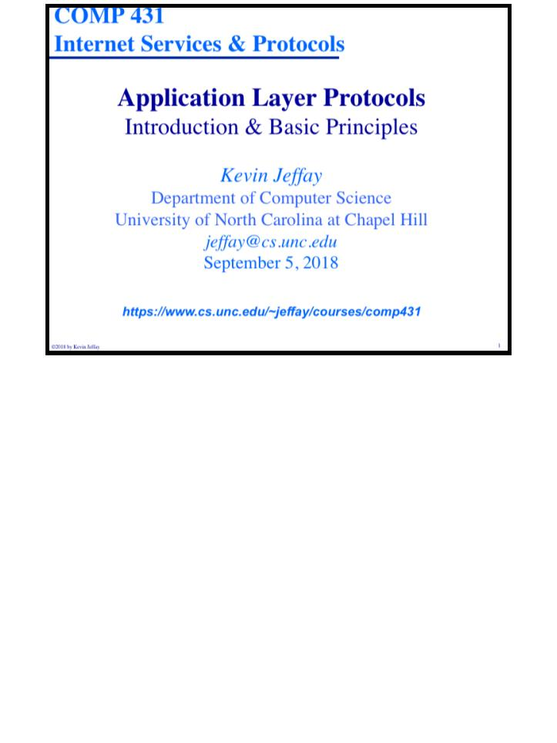
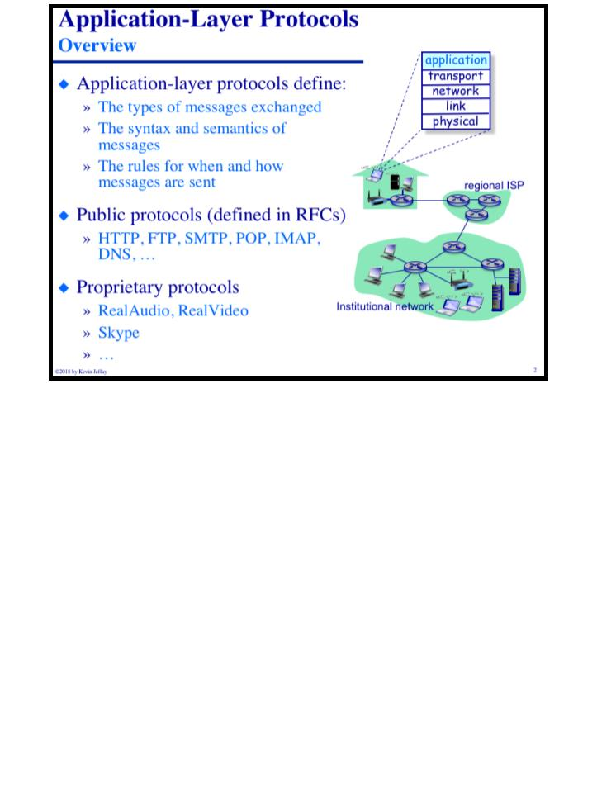
Printed on Saturday, September 1, 2018 at 3:06 PM.
COMP 431
© 2018 by Kevin Jeffay
Lecture 3, Intro&Client/Server Computing
COMP 431
© 2018 by Kevin Jeffay
Lecture 3, Intro&Client/Server Computing
September 5, 2018
September 5, 2018
Page 1
Page 2

Slide 2
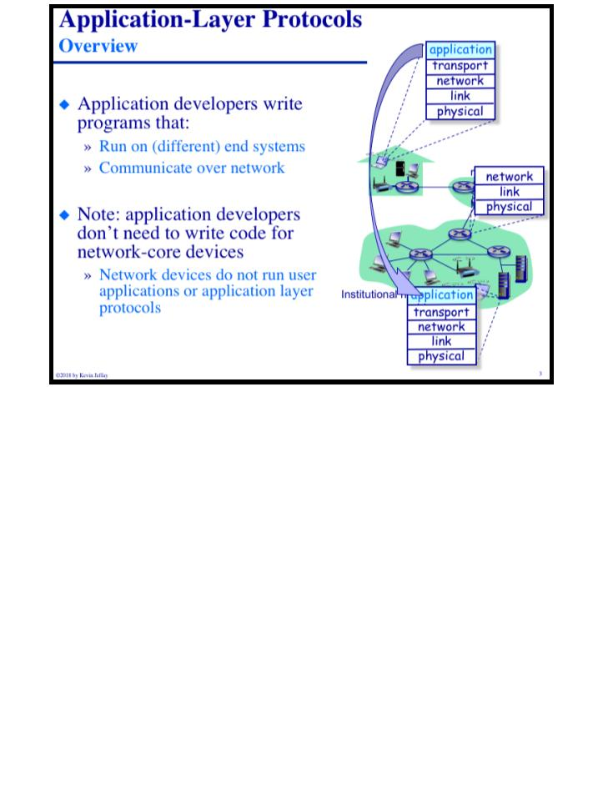
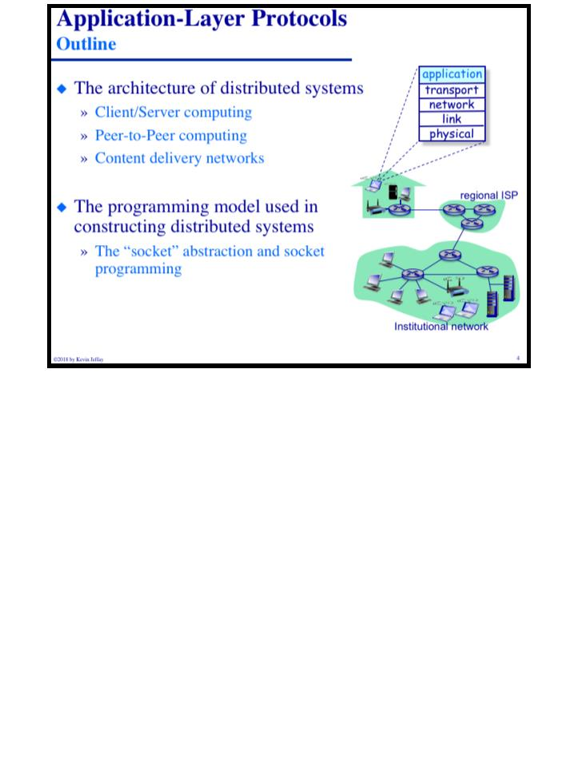
COMP 431
Lecture 3, Intro&Client/Server Computing
September 5, 2018
COMP 431
© 2018 by Kevin Jeffay
Lecture 3, Intro&Client/Server Computing
September 5, 2018
© 2018 by Kevin Jeffay
Page 3
Page 4

Slide 3
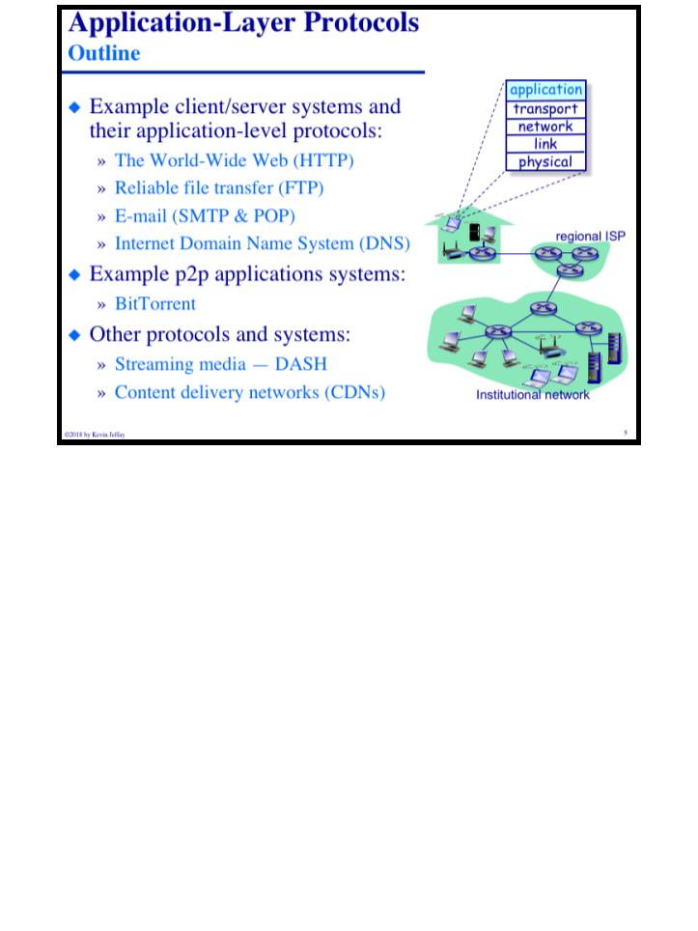
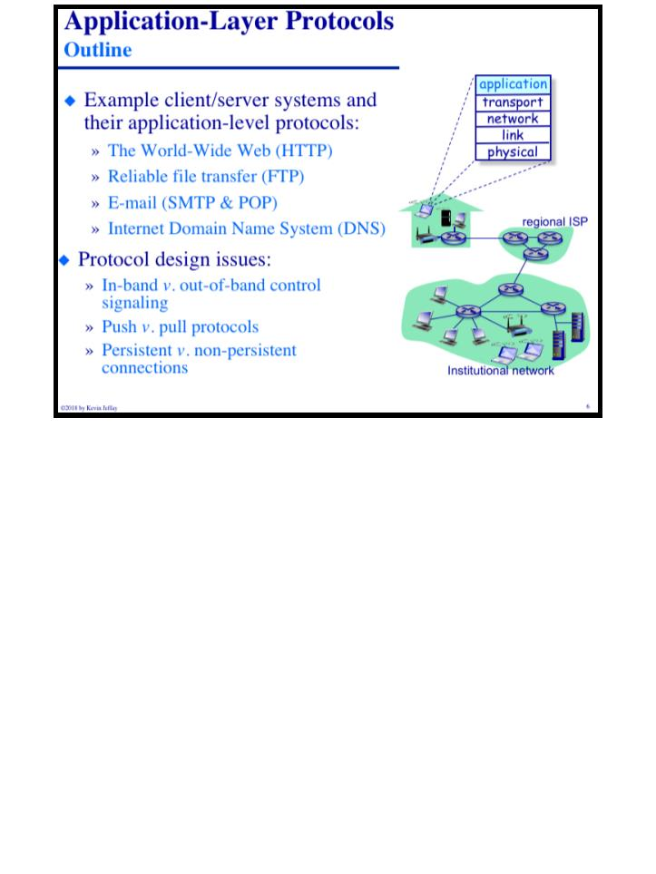
COMP 431
Lecture 3, Intro&Client/Server Computing
September 5, 2018
COMP 431
© 2018 by Kevin Jeffay
Lecture 3, Intro&Client/Server Computing
September 5, 2018
© 2018 by Kevin Jeffay
Page 5
Page 6

Slide 4
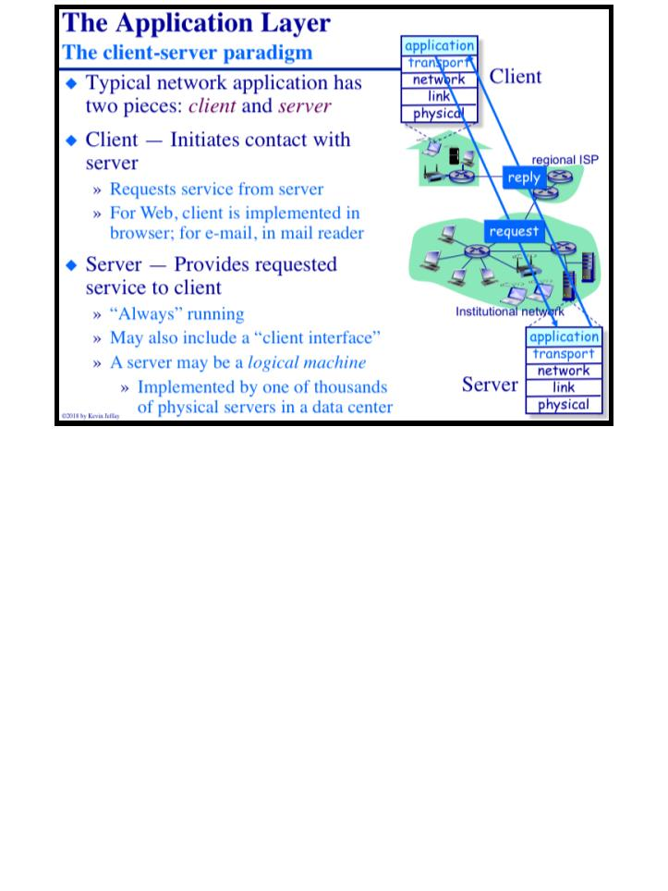
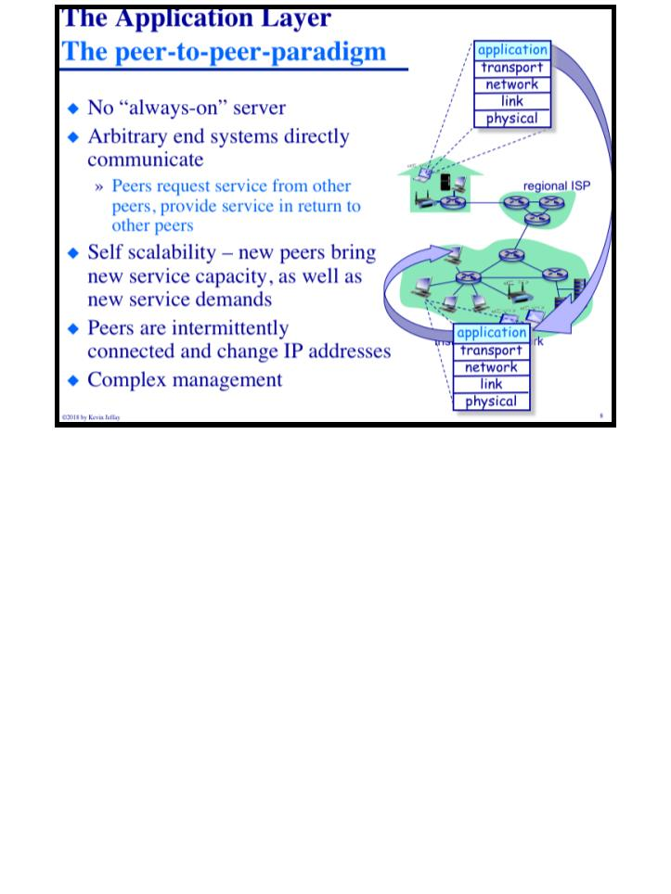
COMP 431
Lecture 3, Intro&Client/Server Computing
September 5, 2018
COMP 431
© 2018 by Kevin Jeffay
Lecture 3, Intro&Client/Server Computing
September 5, 2018
© 2018 by Kevin Jeffay
Page 7
Page 8

Slide 5
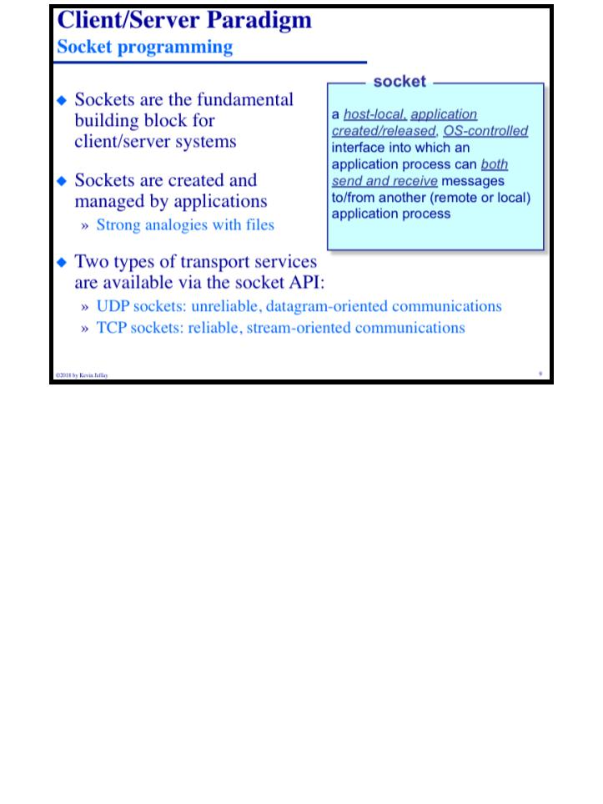
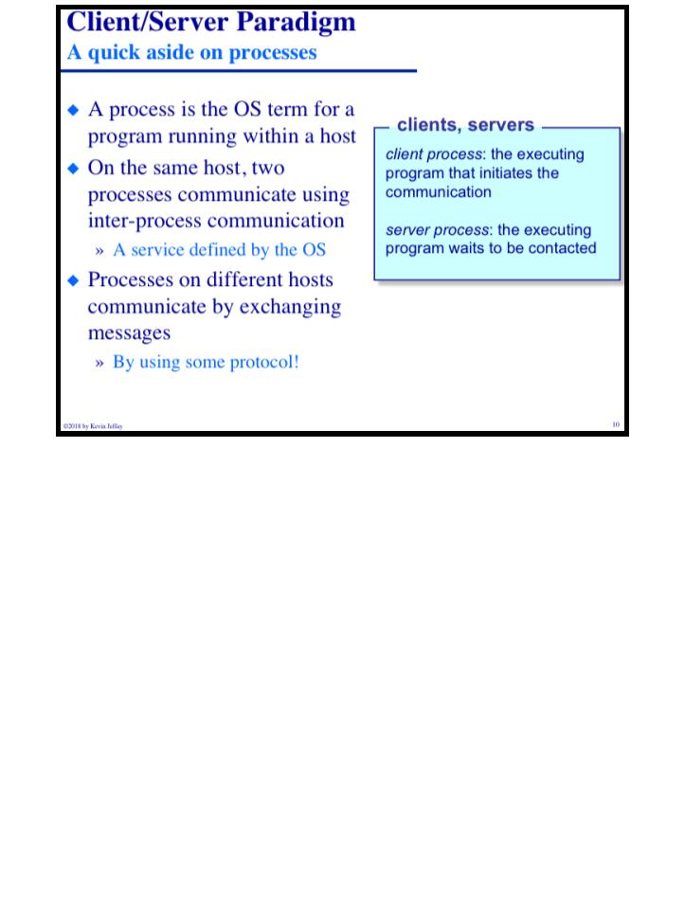
COMP 431
Lecture 3, Intro&Client/Server Computing
September 5, 2018
COMP 431
© 2018 by Kevin Jeffay
Lecture 3, Intro&Client/Server Computing
September 5, 2018
© 2018 by Kevin Jeffay
Page 9
Page 10

Slide 6
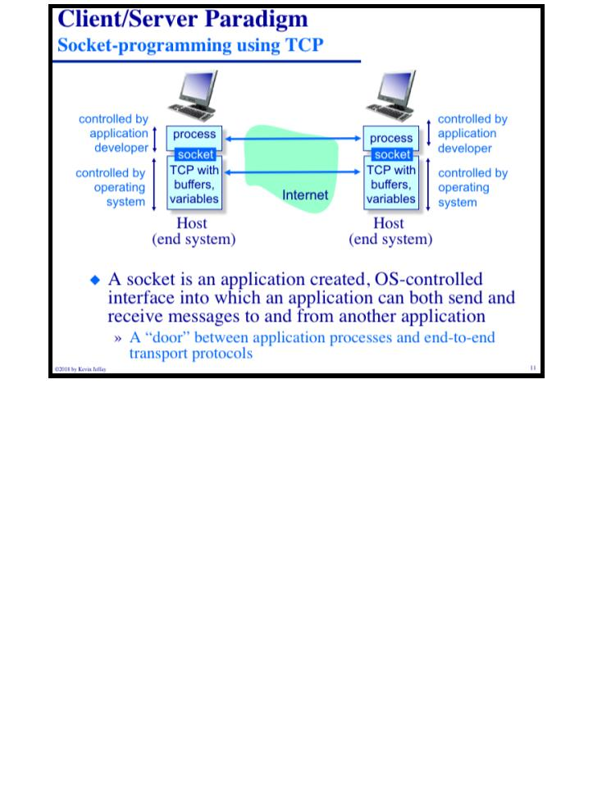
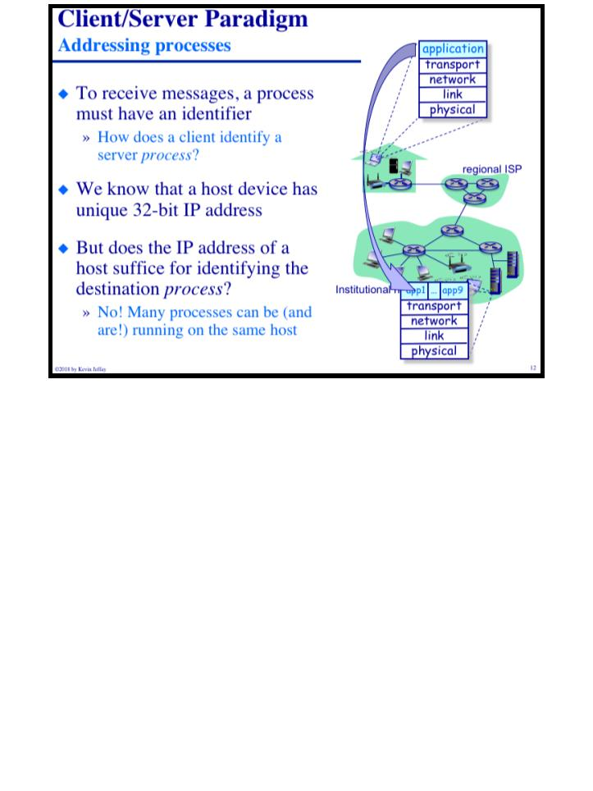
COMP 431
Lecture 3, Intro&Client/Server Computing
September 5, 2018
COMP 431
© 2018 by Kevin Jeffay
Lecture 3, Intro&Client/Server Computing
September 5, 2018
© 2018 by Kevin Jeffay
Page 11
Page 12

Slide 7
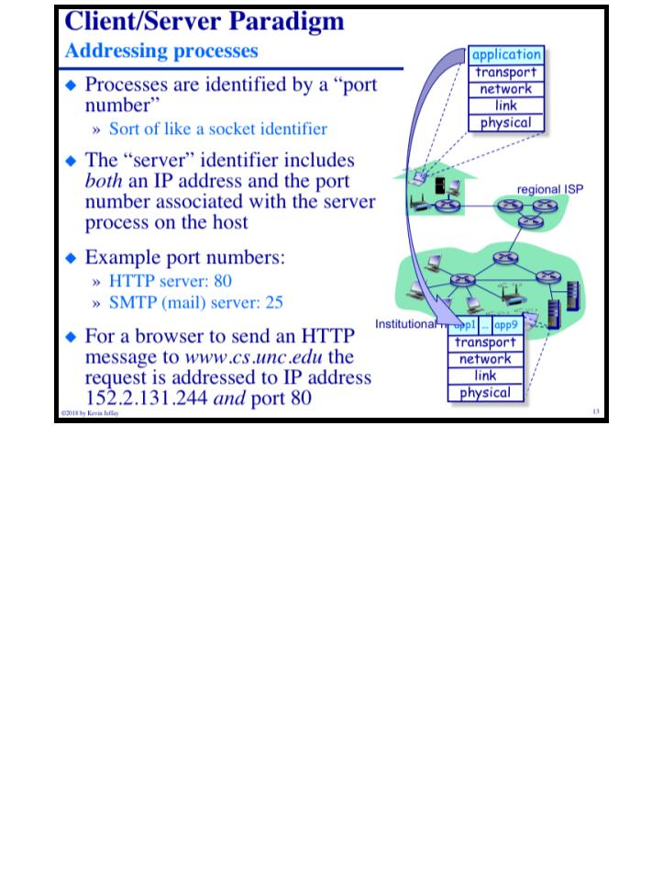
COMP 431
Lecture 3, Intro&Client/Server Computing
September 5, 2018
© 2018 by Kevin Jeffay
Page 13

